Slide 1


Efficient Protein Structure Modeling and Analysis Using Graph Neural Networks
Team Details
Team Number: 94
Sl.Num | Student Name | USN | Roll Num. | Division
1 | Akhila Jaya | 01fe22bcs019 | 407 | D
2 | Ananya M Patil | 01fe22bcs020 | 406 | D
3 | Vijaylaxmi MutalikDesai | 01fe22bcs135 | 423 | D
4 | Omkar Harlapur | 01fe21bcs031 | 464 | D

Slide 2
Introduction
Protein structure prediction is vital for understanding biological function and accelerating drug discovery. Traditional models like AlphaFold2 offer high accuracy but are computationally intensive. This project explores Graph Neural Networks (GNNs) as a lightweight, interpretable alternative for efficient protein structure analysis.

Slide 3
MOTIVATION
AlphaFold2 Limitations:
Requires heavy computational resources.
Acts as a black-box model; lacks interpretability.
Why GNN?
Models proteins as residue-level graphs.
Fast, memory-efficient, and adaptable.
Supports explainable predictions and custom training targets.

Slide 4
PROBLEM DEFINITION
Despite the impressive accuracy of AlphaFold in predicting protein 3D structures, its static representations lack the flexibility and interpretability required for downstream biological tasks. It does not model the dynamic and relational nature of amino acid interactions, making it difficult to extract deeper insights or adapt predictions to specific contexts. This project addresses the need to enhance AlphaFold outputs by using Graph Neural Networks (GNNs) to model residue-level relationships, enabling learnable, interpretable representations that can support more advanced biological analysis.

Slide 5
OBJECTIVES
To construct residue-level graphs from AlphaFold PDB files
To build a GNN model to predict 3D coordinates and confidence (pLDDT).
To evaluate GNN predictions using performance metrics (pLDDT, RMSD).

Slide 6
LITERATURE SURVEY
Category | Details
Authors | Sina Sarparast, Aldo Zaimi, Maximilian Ebert, Michael-Rock Goldsmith
Title | Advanced atom-level representations for protein flexibility prediction utilizing graph neural networks
Year | 2024
Methodology | Developed a GNN model at the atomic level to predict B-factors, indicating protein flexibility, using message passing neural networks.
Dataset | Over 4,000 proteins (~17 million atoms) from the Protein Data Bank (PDB).
Result | Achieved a correlation coefficient of 0.71, outperforming previous methods in predicting protein flexibility.
Gap | Focused on flexibility prediction; further research needed to extend to full 3D structure prediction.

Slide 7
LITERATURE SURVEY
Category | Details
Authors | Can Chen, Jingbo Zhou, Fan Wang, Xue Liu, Dejing Dou
Title | Structure-aware Protein Self-supervised Learning
Year | 2022
Methodology | Proposed a self-supervised learning approach combining GNNs with protein language models to capture structural information from sequences.
Dataset | Multiple protein datasets for pretraining and downstream tasks.
Result | Demonstrated improved performance in protein classification tasks by integrating structural and sequential information.
Gap | Primarily focused on representation learning; application to direct 3D structure prediction remains to be explored.

Slide 8
LITERATURE SURVEY
Category | Details
Authors | Kiarash Jamali, Dari Kimanius, Sjors H. W. Scheres
Title | A Graph Neural Network Approach to Automated Model Building in Cryo-EM Maps
Year | 2022
Methodology | Utilized GNNs to automate the building of protein models from cryo-electron microscopy (cryo-EM) maps, treating amino acids as nodes in a graph.
Dataset | 28 cryo-EM maps with resolutions better than 3.5 Å.
Result | Outperformed state-of-the-art methods, approximating manual model building in cryo-EM data.
Gap | Specific to cryo-EM data; generalization to other types of structural data requires further investigation.

Slide 9
LITERATURE SURVEY
Category | Details
Authors | Zhou H., Wang W., Jin J., Zheng Z., Zhou B.
Title | Graph Neural Network for Protein–Protein Interaction Prediction: A Comparative Study
Year | 2022
Methodology | Conducted a comparative study of various GNN architectures for predicting protein–protein interactions, focusing on node classification tasks.
Dataset | Protein–protein interaction datasets from the Protein Data Bank (PDB).
Result | Demonstrated that GNNs effectively predict interaction sites, with performance varying across different architectures.
Gap | Concentrated on interaction prediction; application to full 3D structure prediction remains to be addressed.

Slide 10
PROPOSED WORK
Extract structure from AlphaFold PDB
Convert to residue graph (nodes = amino acids; edges = spatial proximity)
Integrate pLDDT scores as features
Train GNN (GCN layers) using PyTorch Geometric
Visualize predictions and confidence metrics
Tools Used:
PyTorch Geometric
Biopython
NetworkX / Matplotlib
CSV, NumPy, Pandas
Goal: Learn from structure, go beyond AlphaFold prediction

Slide 11
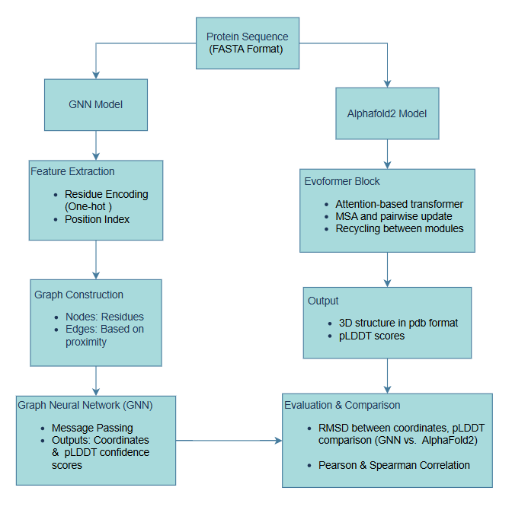
FLOWCHART

Slide 12
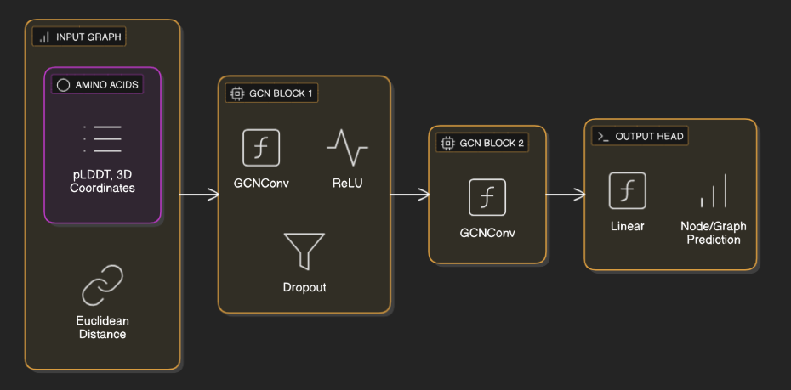
ARCHITECTURE OF GNN MODEL
Input: Graph of amino acids (residues)
Layers:
GCNConv → ReLU → Dropout → GCNConv
Linear → Output prediction (e.g., score or classification)
Features:
Node: pLDDT, 3D coordinates
Edge: Euclidean distance
Output:
Node-level or graph-level representations

Slide 13
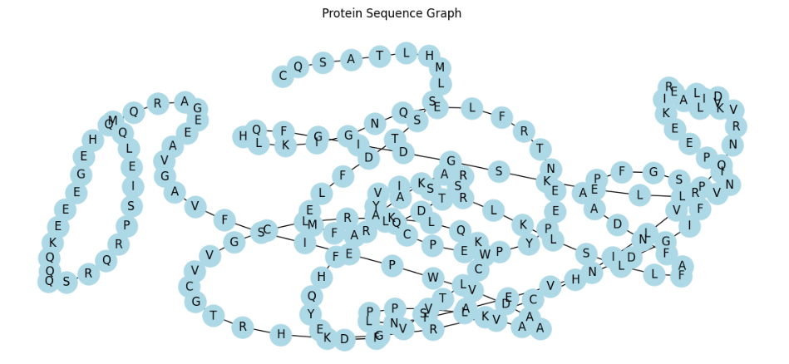
OUTPUT OF THE PROPOSED WORK ​

Slide 14
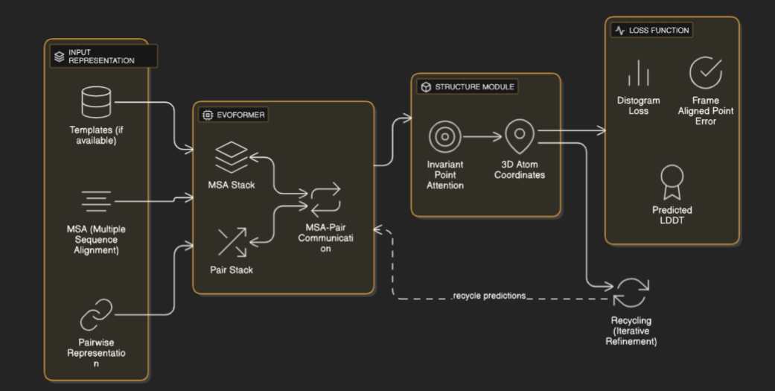
ARCHITECTURE OF ALPHAFOLD2 MODEL

Slide 15
ARCHITECTURE OF ALPHAFOLD2 MODEL
Input:
Protein sequence
Multiple Sequence Alignment (MSA)
Optional structural templates
Evoformer:
A transformer-based module
Processes MSA and pairwise residue features
Captures sequence and spatial relationships
Structure Module:
Predicts 3D atomic coordinates
Uses Invariant Point Attention (IPA) for geometry-aware predictions
Recycling:
Refines predictions through multiple iterations using previous outputs
Output:
Full 3D protein structure
Confidence scores (e.g., pLDDT)

Slide 16
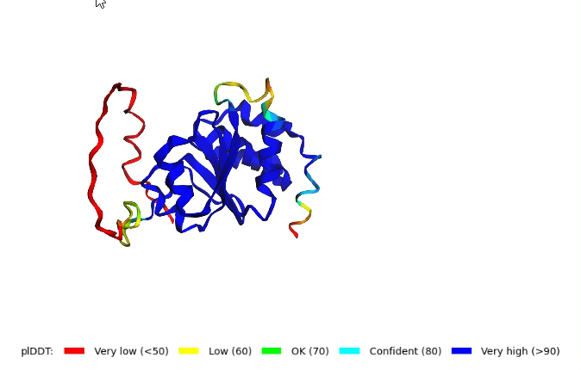
3D STRUCTURE PREDICTION USING ALPHAFOLD2 MODEL
Video demonstration of 3D structure:

Slide 17
DATASET DESCRIPTION
UniProt:
UniProt is the world’s largest and most comprehensive protein database.
It provides detailed, curated information about proteins from many organisms.
Protein Name | Protein Type | PDB ID | Length | Notes
Fatty acid-binding protein, heart | Human protein | AF-P05413 | 133 | Drug target candidate
Inositol diphosphatase DSP2 | Plant protein | AF-Q0DX67 | 204 | Antioxidant enzyme
Protein COBRA | Cobra toxin | AF-Q94KT8 | 456 | Neurotoxic peptide
Polygalacturonase-2 | Tomato enzyme | AF-P05117 | 457 | Crop resistance candidate

Slide 18
DEMO OF PROPOSED WORK
Input:
Protein sequence from Uniprot
AlphaFold2 PDB structures for supervision.
Process:
Construct protein graphs (nodes: residues; edges: pairwise proximity).
Train GNN to predict residue coordinates and pLDDT.
Optimize with loss on distance matrices or coordinate regression.
Tools Used:
Python, PyTorch Geometric (GNN library), Biopython, Pandas.
Jupyter Notebooks (mp1_plant_based.ipynb, etc.)
AlphaFold2 output as benchmark.
Output:
Predicted 3D coordinates.
Predicted pLDDT values (confidence score).
Comparison visualizations and CSVs.

Slide 19
RESULT ANALYSIS
Protein Type | Mode | Elapsed Time | Start Memory | End Memory
Plant-Protein | Alphafold2 | 384.91 seconds | 3759.82 MB | 3891.84 MB
 | GNN | 4.13 seconds | 836.46 MB | 836.98 MB
Human-Protein | Alphafold2 | 257.55 seconds | 4592.98 MB | 4694.90 MB
 | GNN | 5.12 seconds | 816.36 MB | 821.00 MB
Cobra-Toxin | Alphafold2 | 990.00 seconds | 3880.33 MB | 4065.00 MB
 | GNN | 8.67 seconds | 835.95 MB | 836.46 MB
Tomato-Enzyme | Alphafold2 | 1170.04 seconds | 4392.62 MB | 4507.70 MB
 | GNN | 29.90 seconds | 809.14 MB | 816.36 MB
The table clearly shows that the GNN model significantly outperforms AlphaFold2 in terms of both execution time and memory efficiency across all protein types. While AlphaFold2 takes hundreds to over a thousand seconds with high memory usage, GNN completes the same tasks in just a few seconds using under 850 MB of memory. This demonstrates that GNN is a faster and more resource-efficient alternative for protein structure prediction.

Slide 20
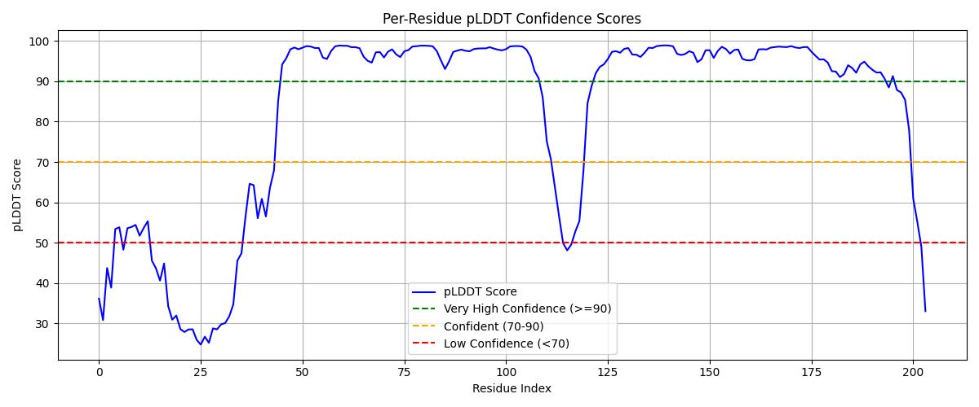
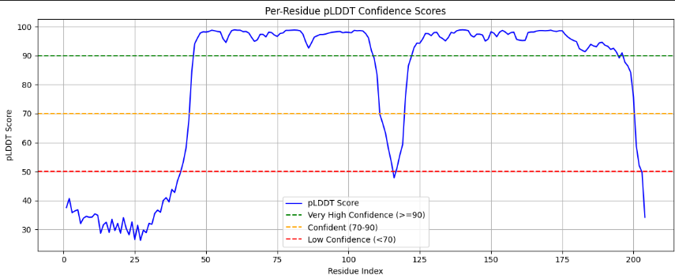
RESULT ANALYSIS
GNN pLDDT Graph
Alphafold pLDDT Graph

Slide 21
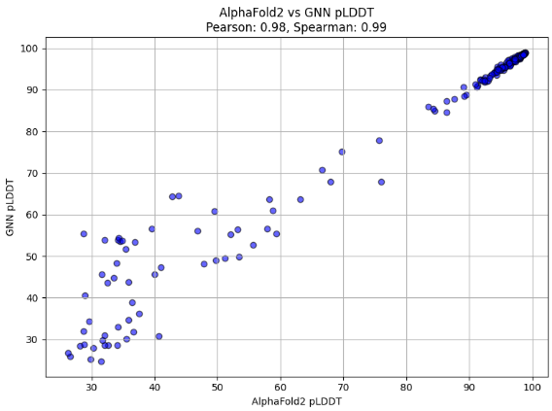
RESULT ANALYSIS
Interpretation of the Output:
Pearson Correlation = 0.98
This measures linear correlation. A value of 0.98 means GNN's pLDDT values track very closely with AlphaFold2 in a straight-line manner.
Spearman Correlation = 0.99
This measures rank correlation (monotonic relationship). A value of 0.99 means the ordering of confidence scores is nearly identical between the two models.
Scatter Plot:
The points lie close to the diagonal line, indicating consistency between AlphaFold2 and GNN predictions across the full range of pLDDT values.

Slide 22
PERFORMANCE METRICS
Parameter | GNN | AlphaFold2 | Why This Proves GNN Is Better
Hardware Requirement | CPU-friendly | GPU-intensive | GNN can run on low-cost systems, democratizing access to protein modeling tools.
Model Interpretability | High (residue-level node outputs) | Low (black-box deep model) | GNN allows explainable predictions — critical for biological insights, especially in drug design or mutation effect analysis.
Customizability | Easily adaptable to tasks like mutation effect, binding site prediction | Difficult to modify | GNN models can be retrained or fine-tuned with domain-specific targets, making them versatile.
Integration Potential | Easy integration into modular ML pipelines | Monolithic and harder to interface | GNNs can be embedded in end-to-end bioinformatics pipelines (ProGen → GNN → Analysis).
Data Format Simplicity | Uses simple graph format (PyTorch Geometric) | Requires MSA, templates, and preprocessing | GNN pipeline is easier to automate and scale.

Slide 23
CONCLUSION
“While AlphaFold2 remains a landmark model in structural biology, our study demonstrates that Graph Neural Networks (GNNs) offer a faster, more interpretable, and resource-efficient solution for protein structure analysis. GNNs enable near real-time inference, low hardware dependency, and flexible design, making them ideal for rapid bioinformatics workflows and educational or clinical environments. Our results suggest that GNNs are not just viable — they are preferable in many practical scenarios.”

Slide 24


INDIVIDUAL CONTRIBUTION TO TEAM
Team members | Contribution
Ananya M Patil | Data collection, Structure Prediction using AlphaFold2 , Report.
Akhila Jaya | Data collection, Generated protein sequences, Efficient graph-based protein modelling, Report.
Vijaylaxmi Mutalik Desai | Data collection, GNN for Protein Structure Analysis, Report.
Omkar Harlapur | Data collection, PPT, Report

Slide 25
THANK YOU

